Slide 1
2023 Social Services Grant (SSG) Pre-Application Meeting August 30, 2022

Slide 2
What’s New for 2023?
Ruth Broder is retiring September 2nd!
CDBG Administrator
Miranda Barfuss
Remove low/mod income as scoring criteria
New review team/City Council split: $400K/$100K
School district representatives added to review team
Non-scoring councilmember added to review team
Lowest/highest application scores thrown out
2
Notes:
Will discuss CDBG schedule at the end of the presentation

Slide 3
Social Services Grant
Name:
Social Services Grant (SSG)
Sponsor:
City of Naperville
Requirements:
Meets funding priority
Funding year:
Jan 1, 2023 – Dec 31, 2023
Funding:
$500,000

Slide 4
Social Services Grant Eligibility Requirements
Eligibility Requirements
Non-profit/not-for-profit 501(c)(3) organization
Provides services or benefit to City of Naperville Community
Meets an objective of the SSG Program
Emergency Services
Seniors
Self-Sufficiency
Special Populations
Youth
Transportation is a subset for each of the main categories
Projects that meet CDBG minimum requirements may be considered for CDBG funding as public services (subject to 15% cap)

Slide 5
Evaluation Criteria for SSG Applications

Slide 6
Meets eligibility requirements:
Will receive a score of
0 – 15 points
501 (c)(3) nonprofit organization
Benefits Naperville residents
Meets one or more SSG objective

Slide 7
Addresses Community Need/Shows Project Impact:
Will receive a score of
0 – 25 points
Benefits Naperville residents
Demonstrates the need for requested service/project
Provides clear description
Shows how request meets goals and objectives
Shows how request will expand existing service
Demonstrates collaboration to avoid duplication

Slide 8
Cost Reasonableness:
Will receive a score of
0 – 20 points
Impact on identified need
How was request determined (quotes, etc)
Why does the agency believe the cost is reasonable (industry standard, etc)
Accuracy and completeness of detailed budget
Good fit with agency's overall budget
Supplemental/leveraged funding

Slide 9
Leveraged Funds
Ratio of matching funds to amount requested
1:1 or more | 10 points
0.75:1 | 8 points
0.50:1 | 5 points
0.25:1 | 3 points
Less than 0.25 | 0 points
 |  | Source of funds
 | Source |  | Amount | T | ype (grant, loan, etc. )
 | 1.
 | 2.
 | Total Project Cost:

Slide 10
Demonstrated Capacity to Complete the Project/Project Readiness:
Staff Skills and Experience Financial Resources Detailed project description/program guidelines | Project Schedule/Ability to complete the project within a year Project sustainability Ability to maintain records and meet contracting and reporting requirements
Will receive a score of 0 - 20 points
Notes:
Does the Agency have the ability to complete project within the timeframe with resources needed? Is the project ready to go as soon as funding is awarded?

Slide 11
0 - 15 points Experience and Past Performance 0 - 5 points Application Completeness
Past performance managing grant funding
Experience with similar projects
All questions completed
All supporting documentation included
Notes:
Does the Agency have the ability to complete project within the timeframe with resources needed? Is the project ready to go as soon as funding is awarded?

Slide 12
2023 Application Timeline
Opening:
Tuesday, September 6, 2022
Deadline:
5 p.m., Friday, September 23, 2022
The CDBG application process is separate and will take place later this year

Slide 13
Using the Online Application System Blackbaud Grantmaking Gifts Online

Slide 14
How to Start a New Application
Links to the applications will be on the City’s website:
SSG webpage:
https://www.naperville.il.us/government/grants/social-services-grant-fund/
CDBG webpage: https://www.naperville.il.us/government/grants/community-development-block-grant-fund/

Slide 15
Getting Started:

Slide 16
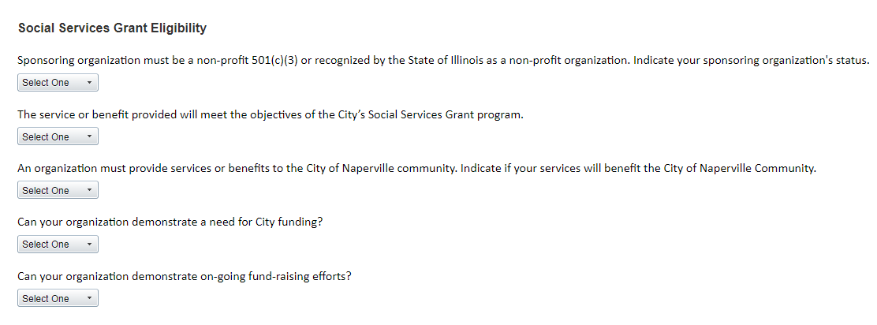
Eligibility Quiz

Slide 17
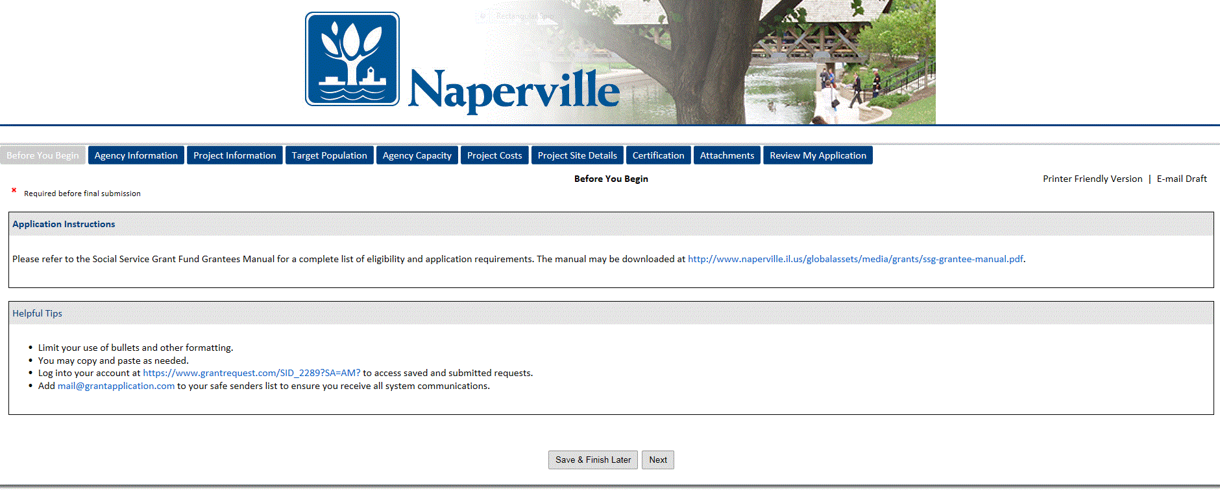

Slide 18
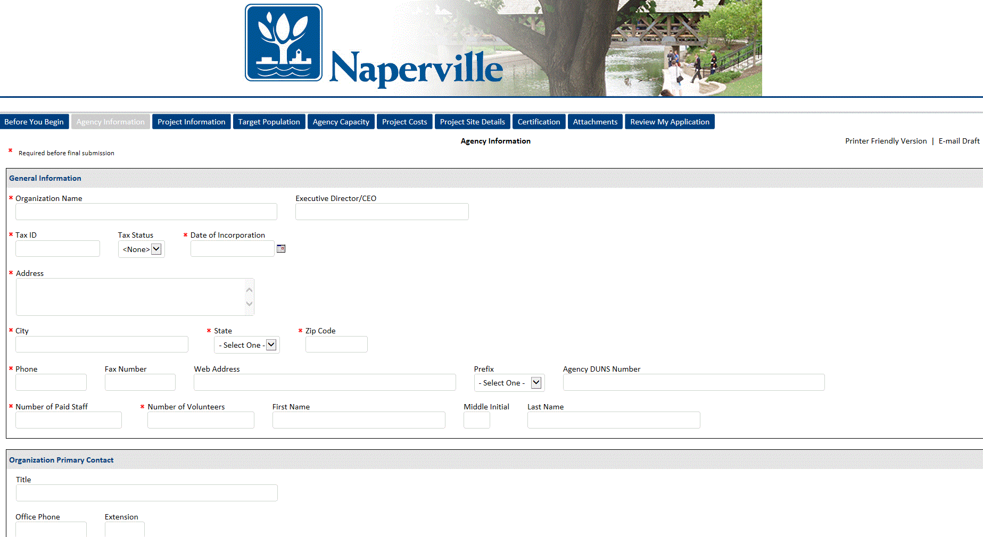

Slide 19
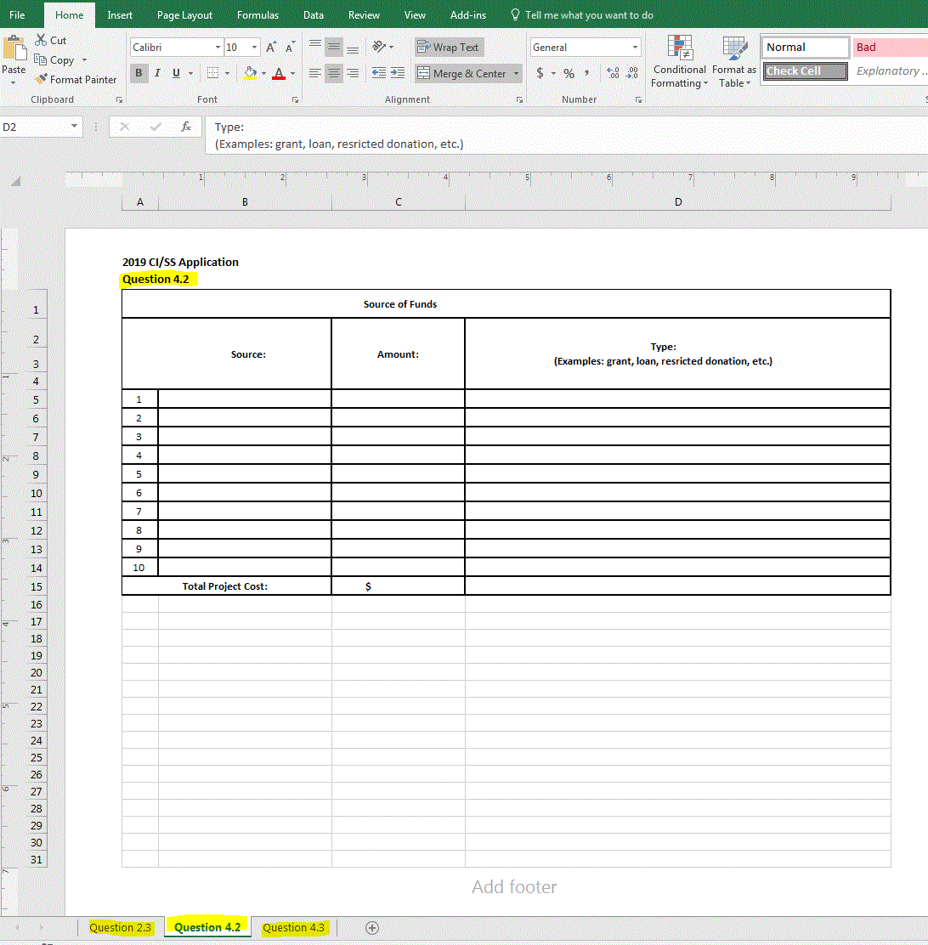

Slide 20
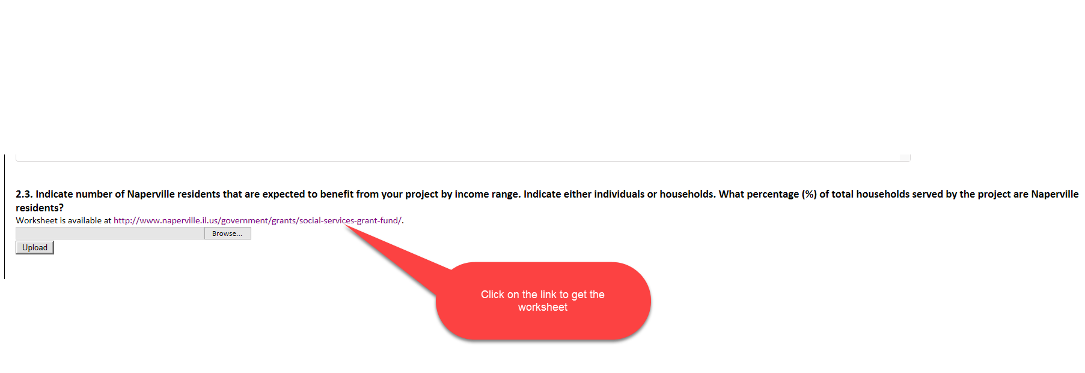
Step 1: Uploading Documents

Slide 21
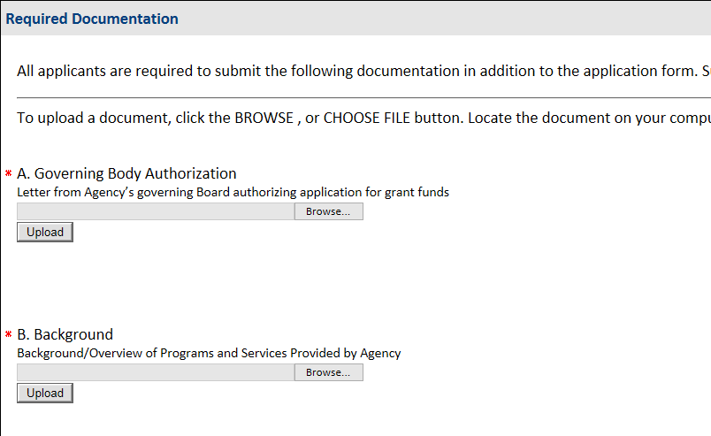
Step 2: Uploading Documents
Successful Uploads will look like this:

Slide 22
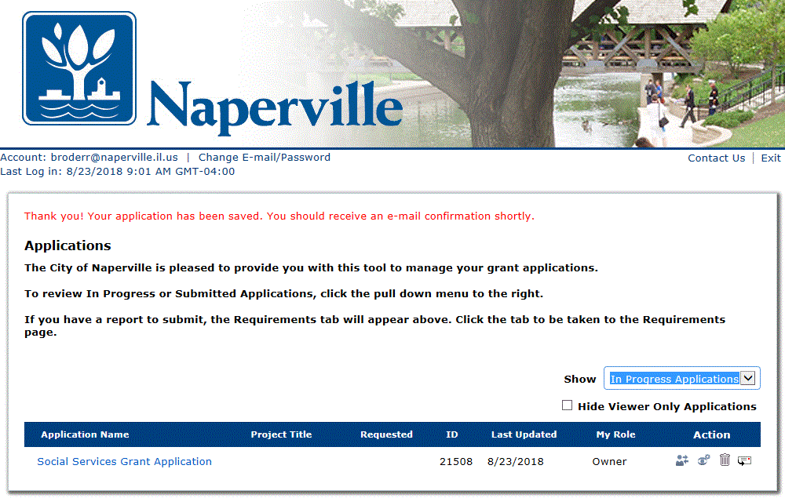

Slide 23
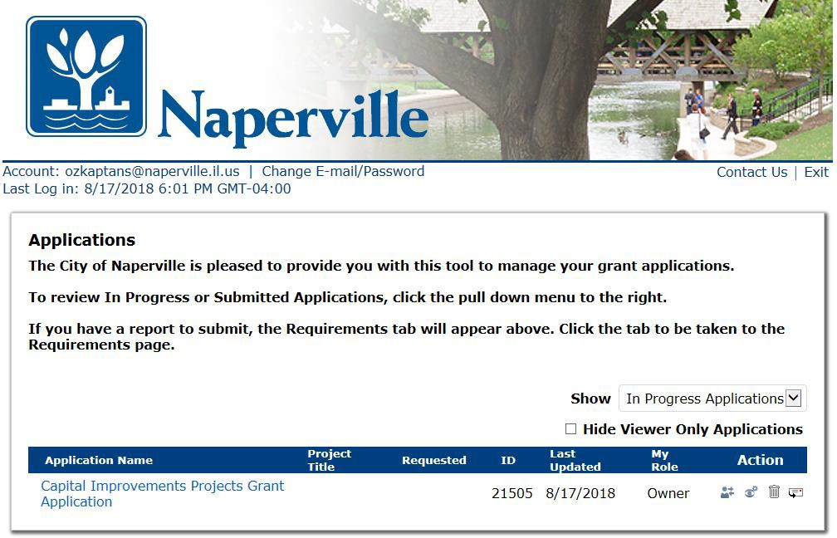
Important! To Return to An Application, Use the Correct Link:
To Log back into your account go to: https://www.grantrequest.com/SID_2289?SA=AM? to access saved and submitted requests. If you don’t use this link, you will create new applications and won’t be able to find your saved applications.

Slide 24
Important Dates To Remember: Aug. 30, 2022 at 11 a.m. - Pre-Application Workshop and Information Session for CY23 grants Sept. 6, 2022 - CY23 Application is open Sept. 23, 2022 - CY23 funding applications are due by 5 p.m. Dec. 2022 - City Council Approval of CY23 Social Services Grant (SSG)allocations Jan. 2023 - CY23 SSG Program Year begins
34

Slide 25
Technical Assistance
For SSG questions, please contact:
Shebnem Ozkaptan
ozkaptans@naperville.il.us (email preferred)
(630) 420-4110
For CDBG Questions, please contact:
Miranda Barfuss
BarfussM@naperville.il.us
(630) 305-5315

Slide 26
Questions?
CDBG Schedule
Can we apply for SSG and CDBG grants?
33

