Slide 1
2023 CDBG Pre-Application Meeting
September 27, 2022

Slide 2
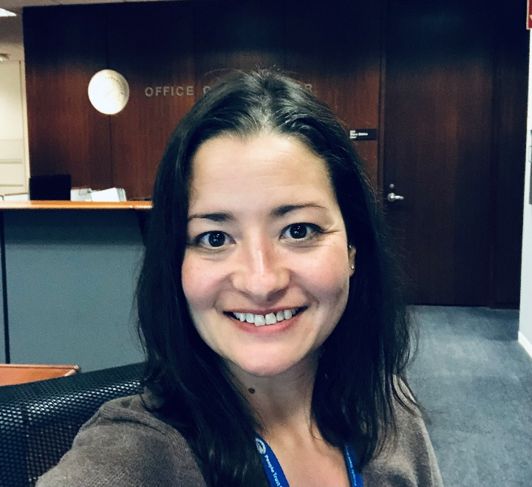
What’s New for 2023?
Me!
Miranda Barfuss
CDBG Administrator
barfussm@naperville.il.us
630-305-5315 phone
630-453-7045 cell phone

Slide 3
Who is Miranda?
Assistant to the Mayor & City Council,
City of Naperville 2020 – 2022
Previously:
TriCity Family Services
Loaves & Fishes Community Services
YMCA of Metropolitan Chicago
College of DuPage Foundation
Naperville Resident
Past President Naperville Jaycees
Wife of Erik, Mother of Sheridan & Rodger
Enjoys reading, writing, Jeopardy, City Council meetings, traveling, fishing and adventuring outdoors

Slide 4
City of Naperville Grant Funding
SECA | SSG | CDBG
Stands for: Special Events & Community Arts | Stands for: Social Service Grant | Stands for: Community Development Block Grant
Sponsor: City of Naperville | Sponsor: City of Naperville | Sponsor: U.S. Dept of Housing & Urban Development (HUD)
Requirements: Event/Project/ Initiative | Requirements: Meets funding priority | Requirements: National Objective/Eligible Activity
Dates: Jan 1, 2023 – Dec 31, 2023 | Dates: Jan 1, 2023 – Dec 31, 2023 | Dates: April 1, 2023 – March 31, 2024
Deadline: Tue 10/04/22 by 12 PM | Deadline: Fri 09/23/22 by 5 PM | Deadline: Fri 10/28/22 by 5 PM

Slide 5
CDBG
Federal grant sponsored by HUD
Naperville is an entitlement community
Awards funds to subrecipients
Estimated funding is $530,000 in this year’s allocation + prior year funding
Must be an eligible activity
Must meet a national objective
Must comply with federal regulations and many administrative requirements
Reimbursement grant

Slide 6
Minimum Requirements
1) Meets Criteria for Eligible Activity
2) Meets a National Objective (NO) of the CDBG Program
Benefits low and moderate income residents;
Aids in the prevention or elimination of slums and blight;
Meets urgent community development needs.
3) Meets at least one priority of the Consolidated Plan
Housing
Homeless
Special Needs
Community Development
Public Services
Project MUST meet all 3 criteria to qualify for funding

Slide 7
1) Eligible Activity:
Acquisition of Real Property – for housing or public facilities
Public Facilities and Improvements – includes housing for homeless and people with disabilities, also infrastructure, handicapped accessibility, senior and youth centers
Rehabilitation – can be Single-Family/Multi-Family, Renter/Owner
Public Services (capped at 15%) – rent assistance, job training, public safety, fair housing, senior services, homeless services, substance abuse counseling, salaries for staff providing direct services to clients
Other Activities - Energy Efficiency/Homeownership Assistance – down payment (50%), closing costs, etc. Economic Development
More Info at: http://portal.hud.gov/hudportal/documents/huddoc?id=DOC_17133.pdf

Slide 8
2) National Objective:
3 ways to show Low- and Moderate-Income Benefit:
1) Income Range of Beneficiary:
At least 51% of units, households or persons helped must be
considered Low or Moderate Income (0-80% MFI)
Extremely Low (0-30% MFI)
Low Income (31-50% MFI)
Moderate Income (51-80% MFI)
2) Presumed Benefit:
Abused Children
Elderly Persons
Battered Spouses
Homeless Persons
Severely Disabled Adults
Illiterate Adults
Persons living with AIDS
Migrant Farm Workers
3) Low/Moderate Income Area Benefits:
▪ Low/Mod Area (see map)

Slide 9
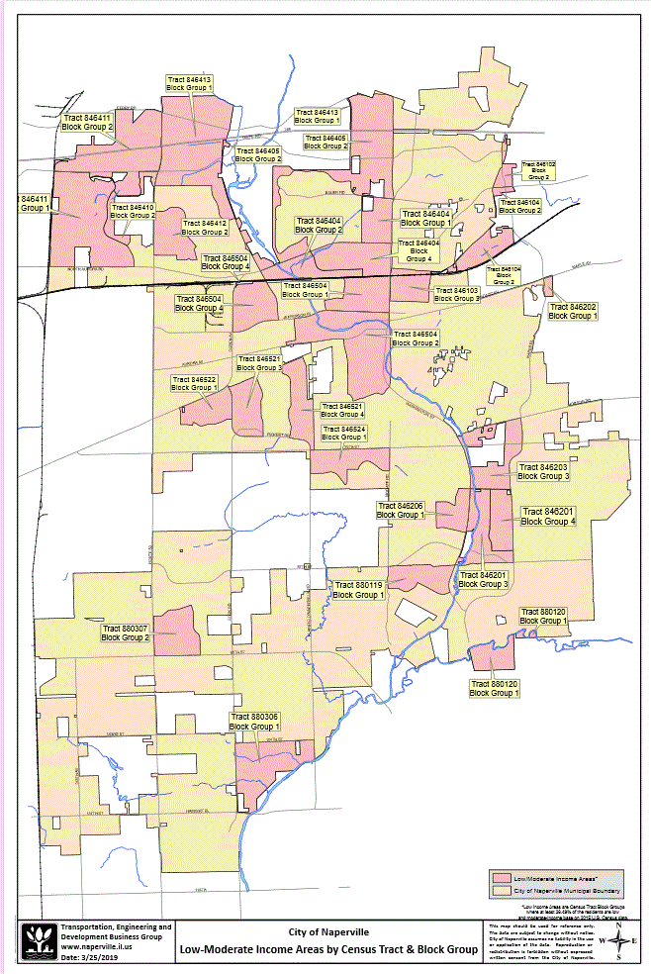

Slide 10
HUD Income Guidelines: Chicago-Joliet-Naperville, IL
Effective 06/15/2022
Household Size | 30% of MFI | 50% of MFI | 80% of MFI
1 | $21,900 | $36,500 | $58,350
2 | $25,000 | $41,700 | $66,700
3 | $28,150 | $46,900 | $75,050
4 | $31,250 | $52,100 | $83,350
5 | $33,750 | $56,300 | $90,050
6 | $36,250 | $60,450 | $96,700
7 | $38,750 | $64,650 | $103,400
8 and more | $41,250 | $68,800 | $110,050

Slide 11
3) Consolidated Plan Priority:
Housing
Affordable housing – Low and moderate-income homeowners/renters
Special needs housing (elderly, disabled, domestic violence, etc.) – Housing and services
Homeless housing – Homelessness prevention, transitional housing, permanent supportive housing
Non-Housing Community Development
Infrastructure
Public and neighborhood facilities
Handicapped accessible public facilities
Public Services
Public services, such as food, shelter, medical care, employment services, financial counseling, mental health/substance abuse counseling, etc.
Economic Development
Assistance to small businesses

Slide 12
Evaluation Criteria

Slide 13
Meets Minimum Requirements of
CDBG Program
10 points
Meets minimum requirements for CDBG
Eligible Activity
National Objective (Low-Mod Benefit)
Consolidated Plan Priority
100% - 76% of served population is below 80% of MFI 10 points
75% - 51% of served population is below 80% of MFI 8 points
50% - 26% of served population is below 80% of MFI 5 points
25% - 1% of served population is below 80% of MFI 3 point
0% of service population is below 80% of MFI 0 points

Slide 14
Project Addresses Documented
Community Need/Project Impact
25 points
Benefits City of Naperville/Naperville Residents
Demonstrates need for this service/project
Provides clear description and evidence
Shows how project/service will meet goals and objectives
Shows how project will expand an existing service or provide a new needed service
Demonstrates collaboration with other agencies to avoid duplication of Services

Slide 15
Cost Reasonableness
20 points
Impact on the identified need
How project costs and funding request were determined (quotes, estimates, etc.)
Why do you consider the cost of this project to be reasonable?
Other indicators of cost reasonableness:
Detailed budget
Good fit with agency’s overall operating budget
Is adequate funding secured?

Slide 16
Demonstrated Capacity to Complete
the Project/Project Readiness
25 points
Does the Agency have the ability to complete the project within the timeframe with resources needed? Is the project ready to go as soon as funding is awarded?
Indicators of project readiness:
Staff Skills and Experience
Financial Resources
Detailed project description/program guidelines
Project Schedule/Ability to complete the project within a year
Project sustainability
Ability to maintain records and meet contracting and reporting requirements

Slide 17
Leveraged Funds
Ratio of matching funds
to amount requested
1:1 or more 10 points
0.75:1 8 points
0.50:1 5 points
0.25:1 3 points
Less than 0.25 0 points

Slide 18
Experience and Past Performance
10 points
Past performance managing grant funding
Experience with similar projects
Highlight any experience you have with CDBG and federally funded grants
Application Completeness
5 points
All questions completed
All Supporting Documentation included

Slide 19
Using the Online Application System

Slide 20
How to Start a New Application
Links to the application is on the City of Naperville website
CDBG webpage:
https://www.naperville.il.us/government/grants/
community-development-block-grant-fund/

Slide 21
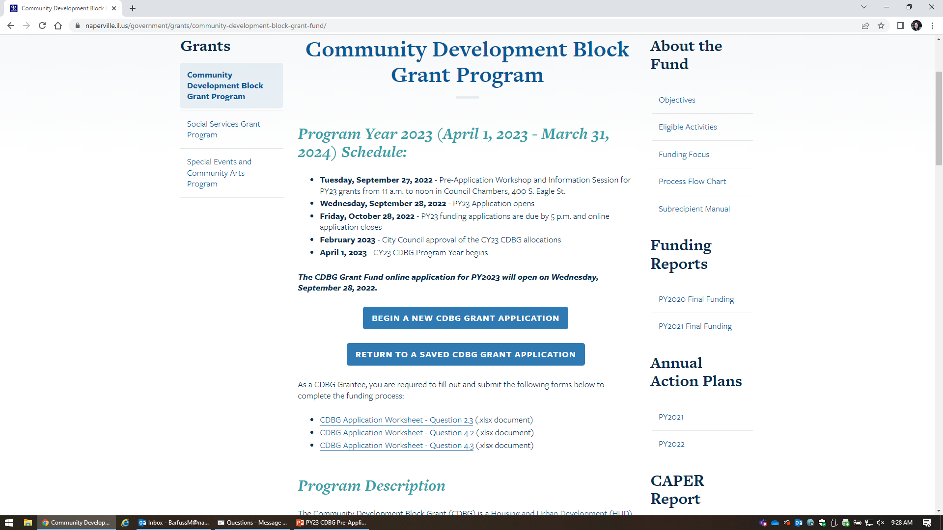
Application

Slide 22
Quiz

Slide 23
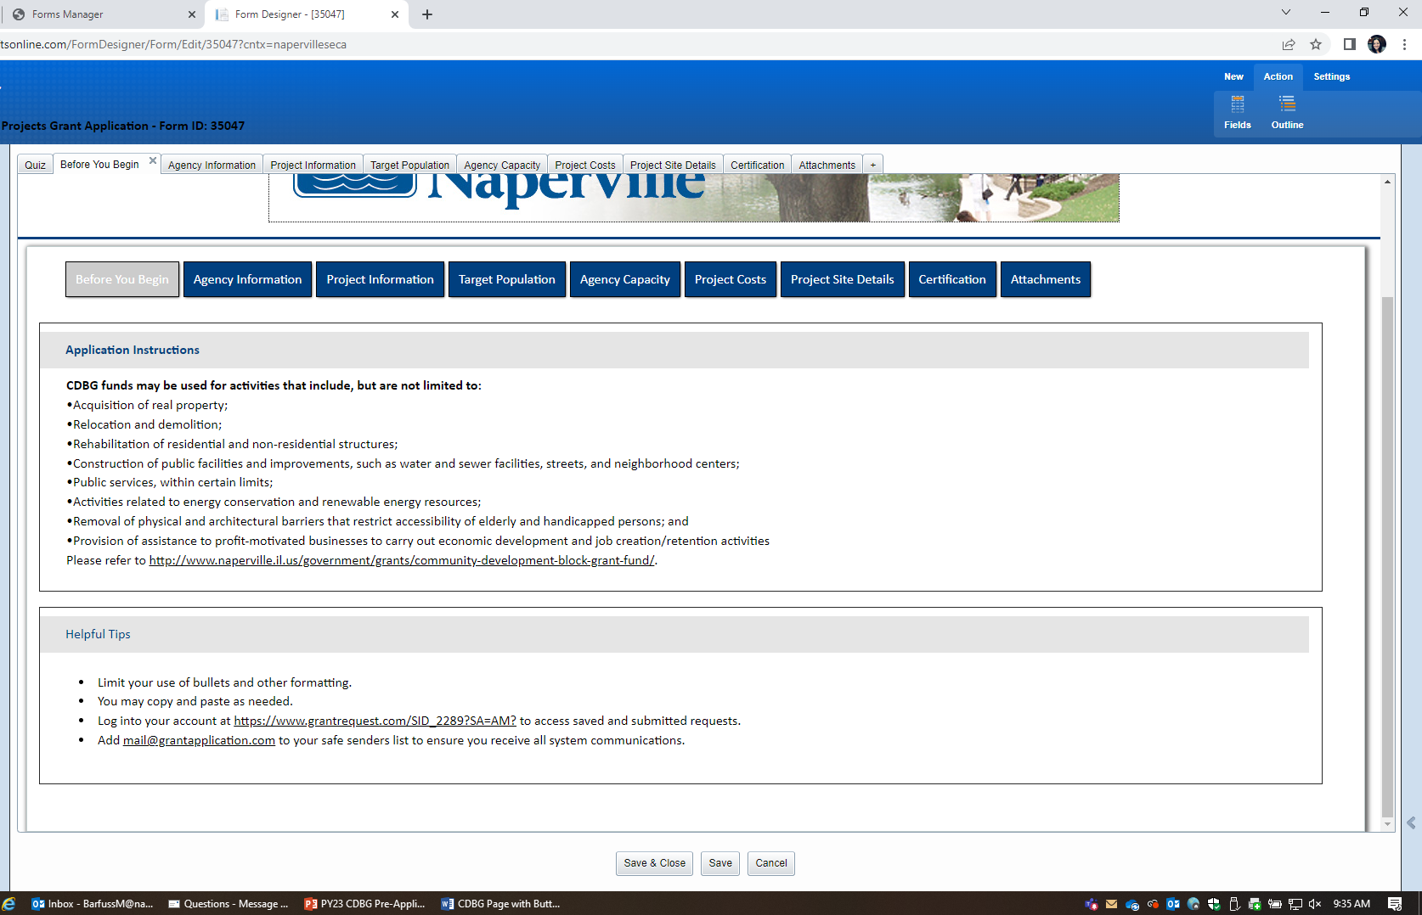
Before You Begin

Slide 24
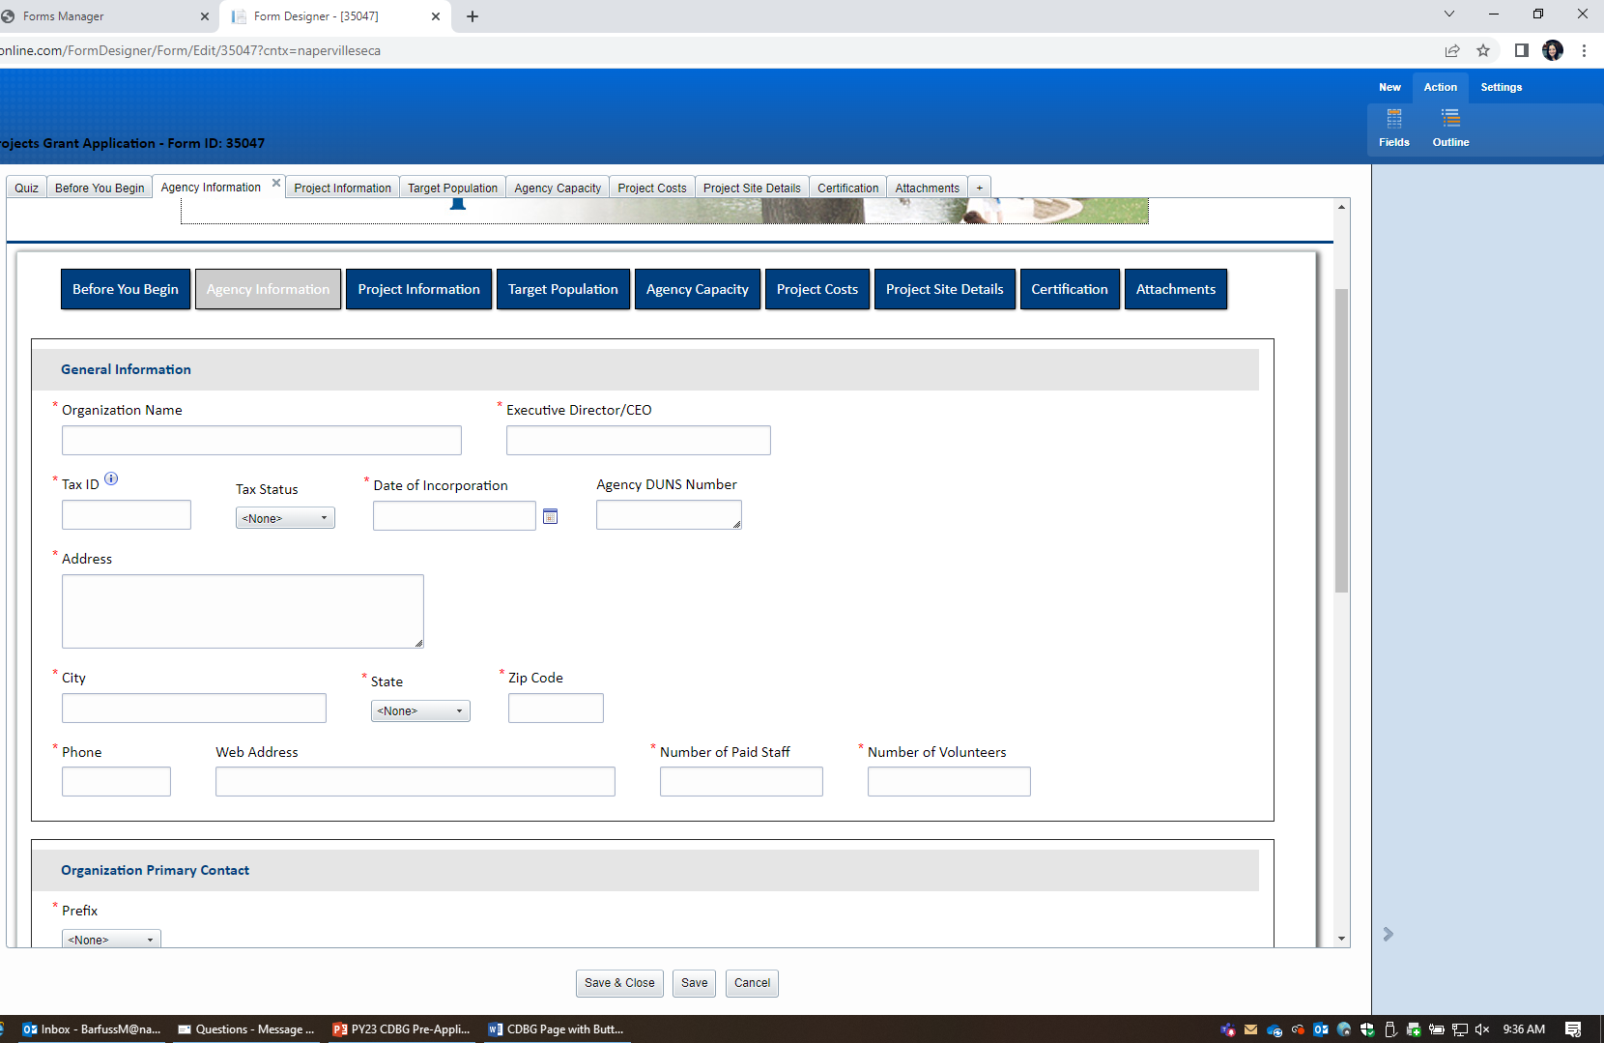
Agency Information

Slide 25
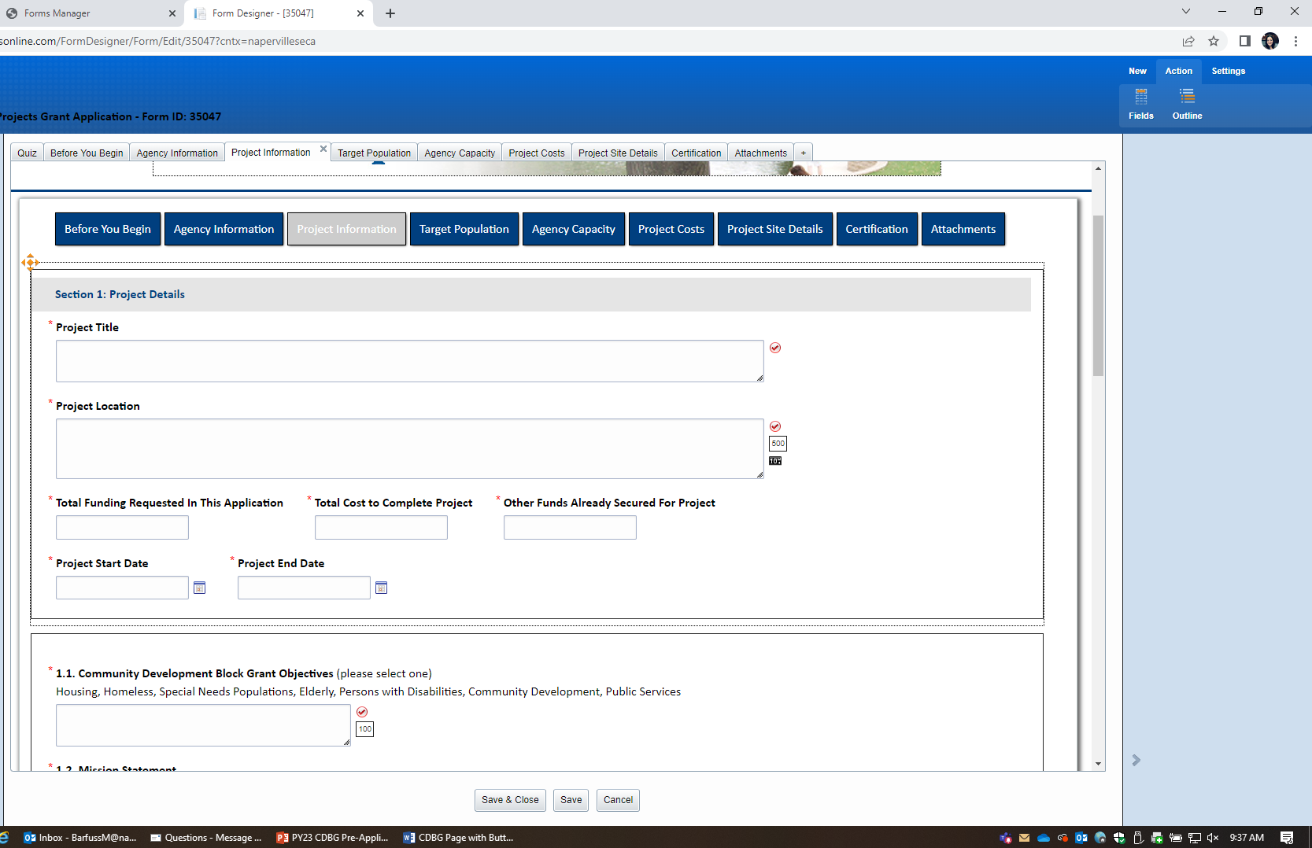
Project Information

Slide 26
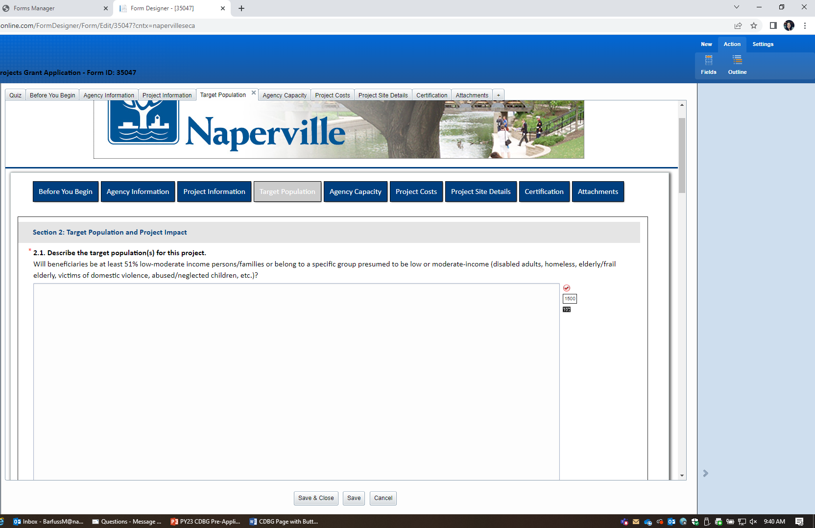
Target Population

Slide 27
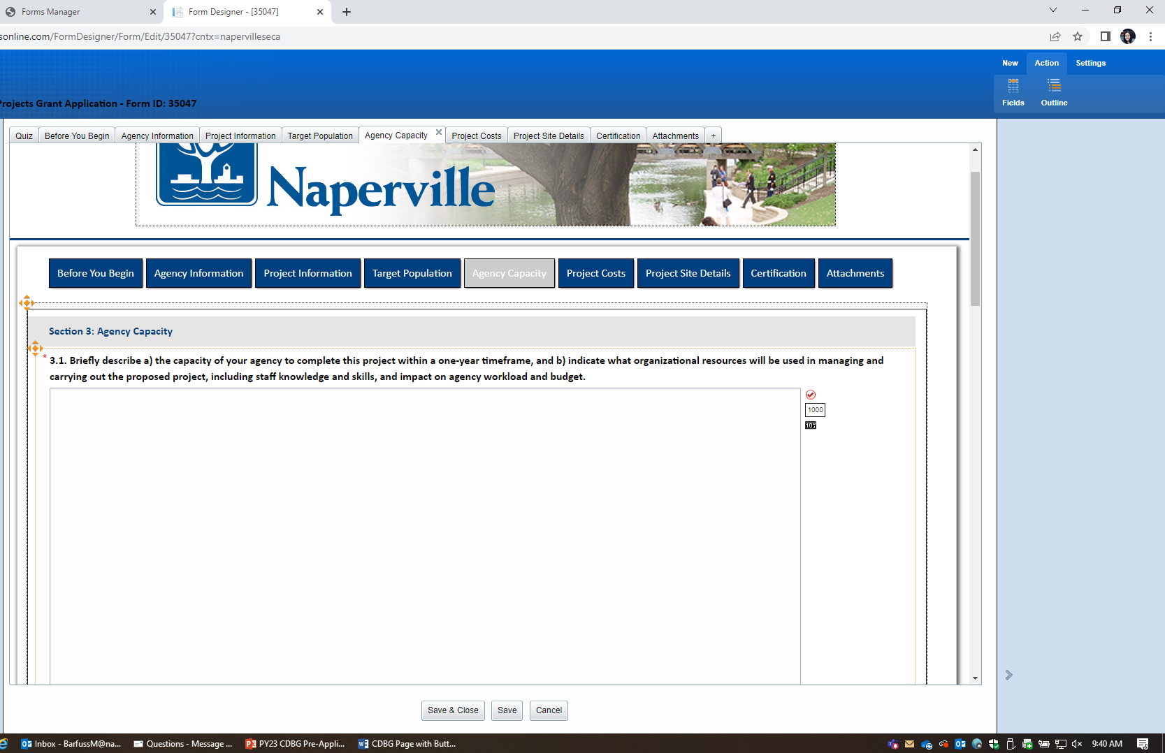
Agency Capacity

Slide 28
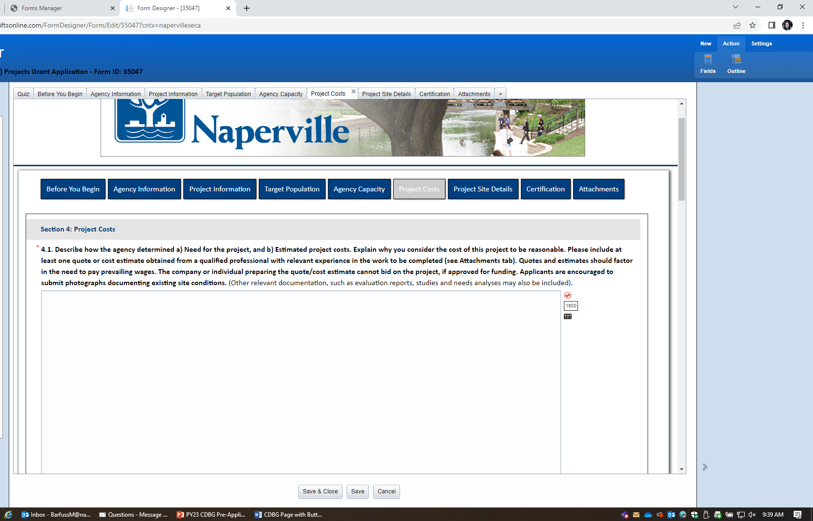
Project Costs

Slide 29
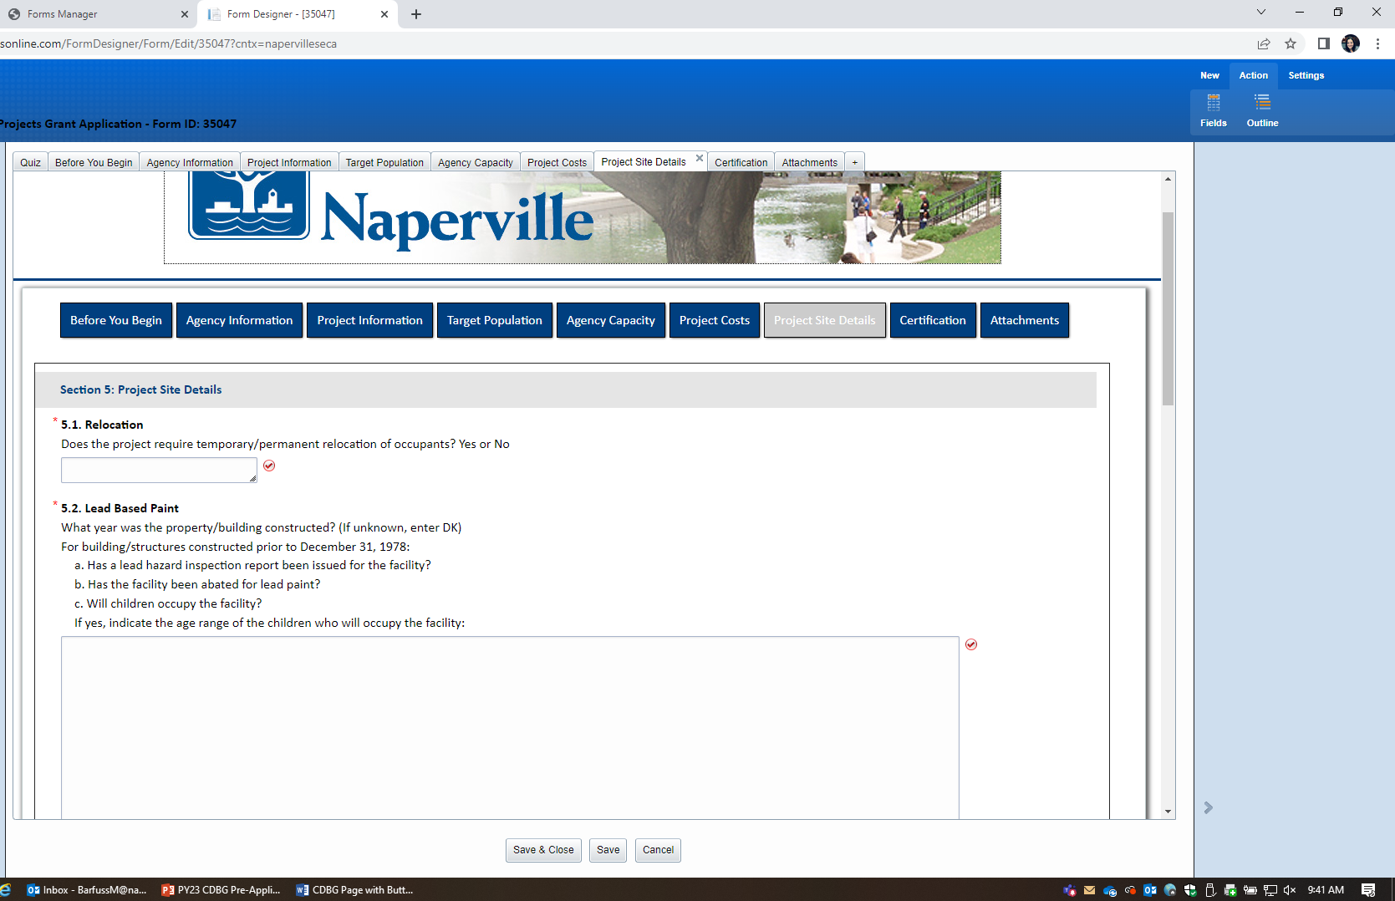
Project Site Details

Slide 30
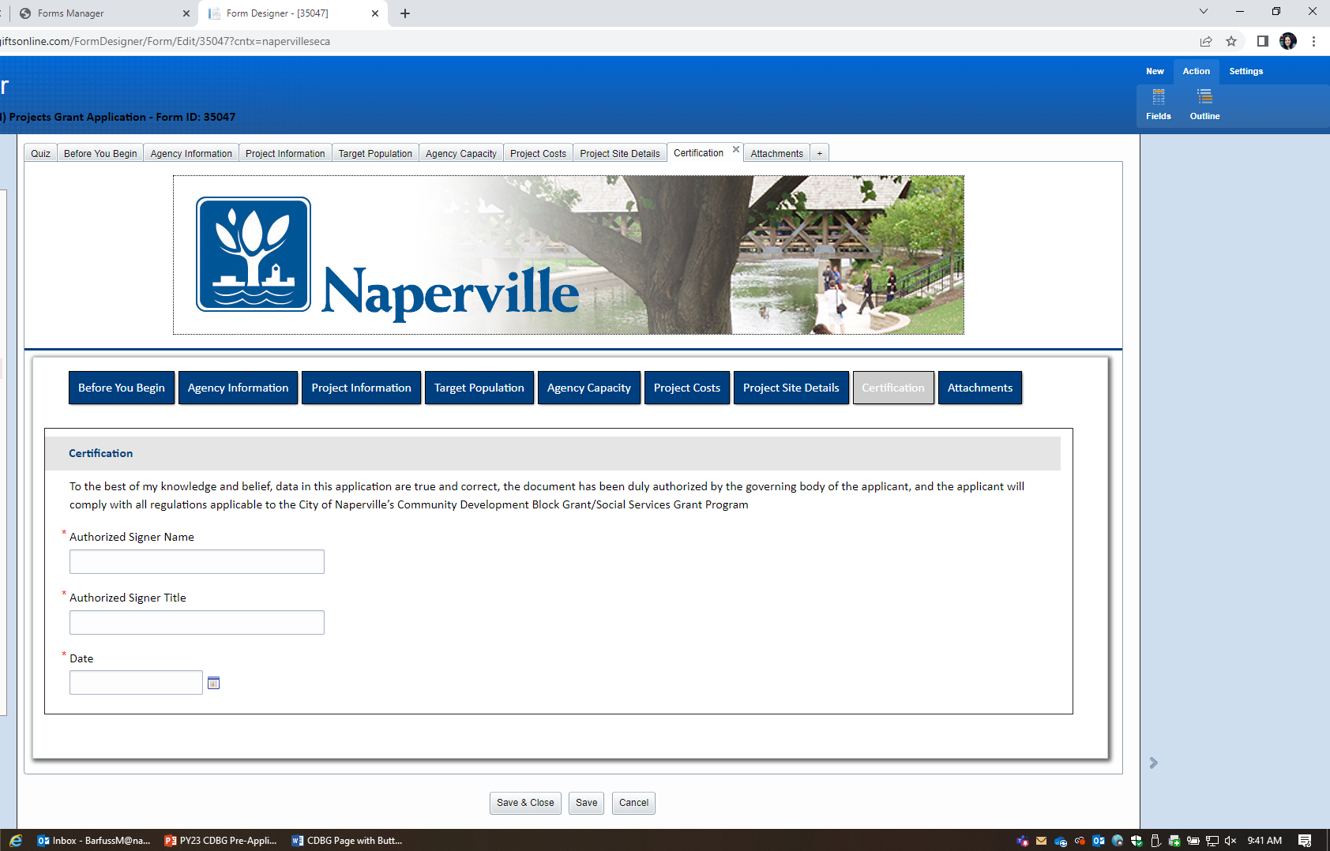
Certification

Slide 31
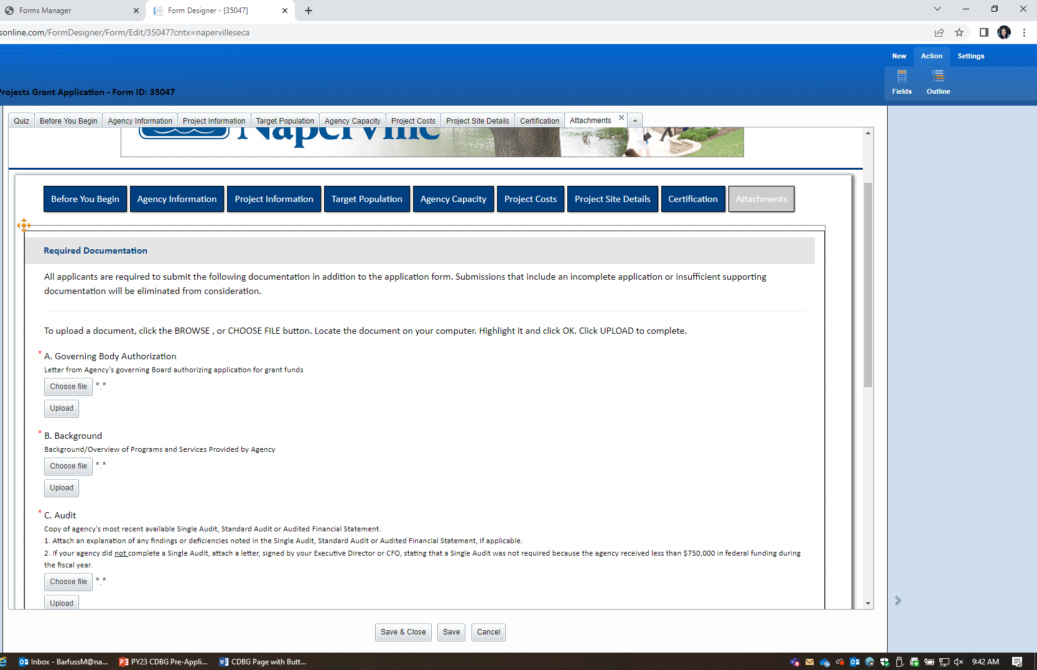
Attachments

Slide 32
Attachments

Slide 33
Next Steps and Dates
Application Opens –
Wednesday, September 28, 2022
Application Due –
Friday, October 28, 2022 by 5:00 PM
City Council Approval – February 2023
CDBG Program Year 2023
April 1, 2023 – March 31, 2023
HUD’s approval is based on approval on the Federal 2023 Budget

Slide 34
FAQ
Can I apply for SECA/SSG/CDBG?
YES
What is the minimum/maximum amount we can apply for?
Recommended minimum: $15,000
What is DUNS #?
DUNS Lookup: https://www.dnb.com/duns-number/lookup.html
Get DUNS: https://www.dnb.com/duns-number/get-a-duns.html

Slide 35
FAQ continued
When will we get confirmation and Notice to Proceed for last year’s grant?
Confirmation on HUD Distribution was received September 9th
Agreements will be sent to you this week and next
How is the transition going?

Slide 36
Thank You!
“There are many wonderful things that will never be done if you don’t do them.” – Charles D. Gill

